Slide 1
CS3.304: Advanced Operating Systems
(L-T-P: 3-1-1. Credits: 4)
P. Krishna Reddy
E-mail: pkreddy@iiit.ac.in
http://www.iiit.ac.in/~pkreddy
Office: Data Sciences and Analytics Center (DSAC)

Slide 2
Course topics
Unit 1: Introduction, Computer System Hardware Review, Networking (9 hours)
Unit 2: Operating System Structures, Virtual machines, Process and thread management (9 hours);
Unit 3: CPU scheduling, Process Synchronization, Deadlocks (10 hours);
Unit 4: Memory management, Virtual memory (10 hours);
Unit 5: File systems, Hadoop, Map Reduce, Overview of Protection, Security, Multi-media systems, OS design principles (6 hours);

Slide 3
Last lecture
  Operating system definition
  Every tool has machine part and operating part
  Operating system is an operating part of a toll called “computer system”
  Coping with complexity with right modularity right abstraction, right layering, right hierarchy, and ITERATION by starting with simple system
This lecture
  History, development and concepts of Operating Systems
  Multiprogramming and timesharing

Slide 4
Outline
History, development and concepts of Operating Systems
Different kinds of Computer Systems
Concept of virtual computer

Slide 5
Stored Program Computer
1940
  Computers were designed to perform specific tasks.
  Modification of the tasks required a great deal of effort and manual labour
Alan Turing and John von Neumann
  Proposed the concept of stored program computer.
  Machine has both program store and data store and program store provides instructions about what to do on data.
  This concept has generated the concept of general purpose computer.
Watch the movie
  The Imitation Game
1951
  First general purpose computer
    Machester Mark 1 (ran duriing 1940 to 1949)
  First general purpose commercial computer was available in the market
    Ferranti Mark1

Slide 6
Early systems (Serial processing)
1940-50:
  The programmer interacted directly with the computer hardware.
  Display light, switches, printer, card reader.
  No OS.
  Error is displayed through lights.
Problems:
  Scheduling → Users spend lots of time at the computer.
    Signup sheet was used.
  Job Setup time
    Loading and compiling
      Mounting and Un-mounting of tapes
      Setting up of card desks
  Libraries of functions, linkers, loaders, debuggers, and I/O driver routines were available for all the users.

Slide 7
Early Systems…
Early computers were (physically) large machines run from a console.
The programmer would operate the program directly from the console.
  The program is loaded to the memory from panel of switches, paper tape, and from punched cards.
As time went on, additional software and hardware were developed.
  Card readers, line printers, and magnetic tape became common place.
  Libraries, loaders, and common functions were created.
    Software reusability.

Slide 8
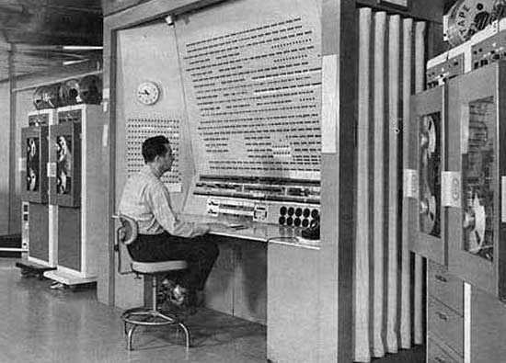

Slide 9
Early Systems…
The routines that performed I/O were especially became important.
Device driver: A special subroutine was written for each I/O device.
  A device driver knows how the buffers, flags, registers, control bits, and status bits for a particular device should be used.
  Device driver is written once and called from the library.
Later, compilers for FORTRAN, COBOL and other languages have appeared.

Slide 10
Early Systems…
Significant amount of setup time.
Each job consisted of many separate steps:
  Loading the FORTRAN compiler tape
  Running the compiler
  Unloading the compiler tape
  Loading of assembler tape
  Running assembler
  Unloading the assemble tape
  Loading the object program
  Running the object program
If error occurred during any step, you have to start over at the beginning.

Slide 11
Early Systems..
The setup time was a real problem
CPU is idle while tapes are being mounted or the programmer was operating the console.
In the early days, few computers were available and they were expensive (millions of dollars).
  +operational costs: power, cooling, programmers.
Main question:
How to increase the utilization of CPU?

Slide 12
Early Systems…
The solution was two fold.
First, a professional computer operator was hired.
  Once the program was finished, he operator could start next job.
  The operator sets up the job, produces the dump, and starts the next job.
  The set up time was reduced due to operator’s experience.
Second, jobs with similar needs were batched together and run through the computer as a group.
  For example, if there is a FORTRAN job, COBOL job, and FORTRAN job, two FORTRAN jobs were batched together.
However, during transition time CPU sat idle.
To overcome this idle time, people developed automatic job sequencing.
  A first rudimentary OS was created
  A small program called a resident monitor was developed.
  The resident monitor always resided in memory.

Slide 13
Simple Batch Systems ( early 1960s)
In serial systems
  Machines were very expensive
  Wasting time was not acceptable.
To improve usage, the concept of batch OS was developed.
The main idea is the use of software known as monitor.
  The user no longer has access to machine.
The user submits the job (tape) to the operator.
The operator batches the jobs together sequentially, places entire batch as an input device for use by the computer.

Slide 14
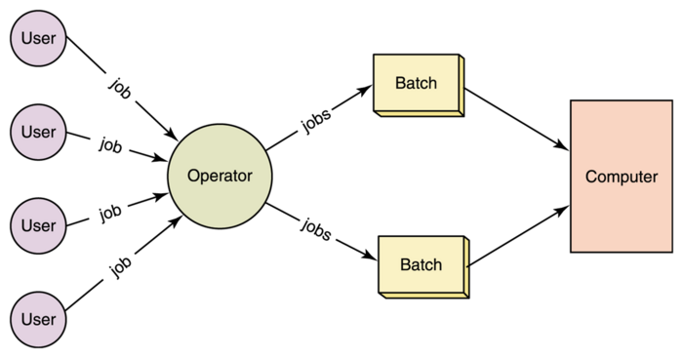

Slide 15
Memory Layout for a Simple Batch System
Interrupt procedures
Device drivers
Monitor
Job sequencing
Command language
interpreter
Boundary
User program
area
Resident monitor

Slide 16
Simple Batch Systems..
At the beginning of any job, the corresponding subroutines and functions are loaded.
The monitor reads the jobs one at a time from the input device.
ALGORITHM FOR MONITOR (or Operating System)
  The control is passed to the user’s program.
    Processor is fetching and executing user’s instructions.
  After completion, the control is returned to the monitor program
    Processor is fetching and executing monitor instructions.

Slide 17
The task performed by CPU when CPU is idle.
Loop no operation
JUMP loop

Slide 18
Features of Batch System
The batch OS is simply a program.
It relies on the ability of the processor to fetch instructions from various portions of main memory to seize and relinquish control.
Hardware features:
  Memory protection: While the user program is running, it must not alter the memory area containing the monitor.
    If such is the case the processor hardware should detect the error and transfer control to monitor.
  Timer: A timer is used to prevent the single job from monopolizing the system
  Privileged instructions
    Contains instructions that are only executed by monitor.
    I/O instructions
    If a program encounters them the control shifts through monitor..
  Interrupts: It gives OS more flexibility.
    Relinquishing control and regain control

Slide 19
Features of Batch System
With batch OS, the machine time alters between execution of user programs and execution of monitor.
Two overheads
  Machine time is consumed by the monitor.
  Memory is consumed by the monitor.
Still, they improved the performance over serial systems.

Slide 20
Problems with the Batch System
CPU is idle
  Speed of mechanical devices is very slower than those of electronic devices.
CPU works in a microsecond range
  Thousands of instructions/second
A card reader may read 1200 cards per minute
  (20 cards per second)
CPU speed has increased at a faster rate.
Tape technology improved the performance little-bit.
Main perceived problem
  Turn-around time: up to two days
  CPU often underutilized
    Most of the time was spent reading and writing from tape.

Slide 21
Resident monitor: summary
Automatic job sequencing
  Use of control cards
Job control language
  Commands
    Mount this tape
    Compile
    Run
OSs begin to be important.
  IBM: Fortran monitor system
Main perceived problems
  Turn-around time
  Inexpensive use of expensive hardware
  CPU is still mostly idle.

Slide 22
Spooling
The introduction of disk technology helped in this regard.
Disk technology introduced the SPOOLing (Simultaneous Peripheral Operations On-Line)
Considers disk as a huge buffer.
Input comes from the disk
Output goes to the disk.
DISK
Card
Reader
Line
Printer
CPU

Slide 23
Advantage of Spooling
Reading can be done in advance.
Output can be stored on the disk.
Spooling is also used for processing data at remote sites.
Spooling overlaps the I/O of one job and computation of other jobs.
  Even printing and reading can overlap.
Spooling can keep both the CPU and the I/O devices working at higher rates.
Disk is a random access device.

Slide 24

Multi-programmed Batched Systems
(1960s) (or Multi tasking)
A single user can not keep either CPU or I/O busy.
Multiprogramming increases CPU utilization by organizing jobs such that the CPU always has one to execute.
The OS keeps several jobs in memory at a time and CPU is multiplexed among them

Slide 25
Multi-programmed Batch Systems
If CPU is executing a job and requires a tape to be mounted
  In a non multi-programmed system
    CPU sits idle.
  In a Multi-programmed system
    CPU takes up another job.
Multiprogramming is the first instance when the OS started taking decisions.
Job scheduling is done by OS.
Having several programs in the memory requires memory management.

Slide 26
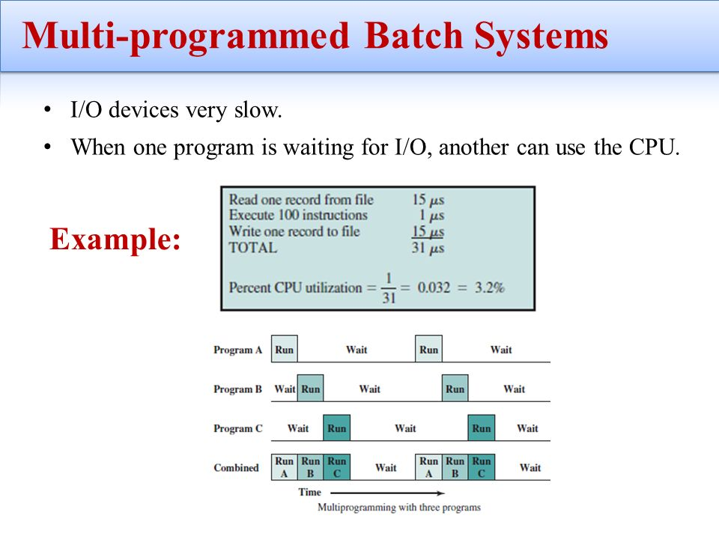

Slide 27
OS Features Needed for Multiprogramming
I/O routine supplied by the system.
Memory management –
  the system must allocate the memory to several jobs.
CPU scheduling –
  the system must choose among several jobs ready to run.
Allocation of devices.

Slide 28
Time-Sharing Systems–Interactive Computing
With multiprogramming
  Utilization is okay.
  But, response time was a problem.
Timesharing:
  Programs could interact with user.
Programs
  Could wait for I/O for arbitrary time
    CPU switched to another job.
    However, resident jobs took up valuable memory
      Needed to be swapped out to disk
      Virtual memory.
Time-sharing systems were developed to provide interactive use of a computer system at a reasonable cost.

Slide 29
Time-Sharing Systems–Interactive Computing
A time sharing system uses CPU scheduling and multi-programming to provide each user with a small portion of a time shared computer.
A program that is loaded into a memory and is executing is commonly known as a process.
In timesharing system, a process executes for only a short time.
  I/O is at people speeds, but OS can switch rapidly.
A time-shared OS system allows the many users to share the computer simultaneously.
It gives the impression that the user has own computer, whereas actually a computer is shared among many users.

Slide 30
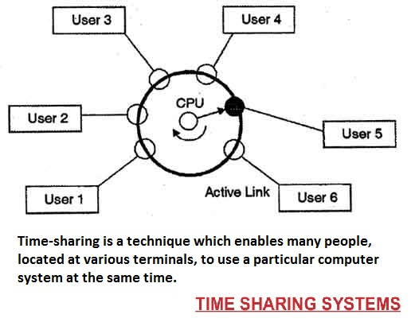

Slide 31
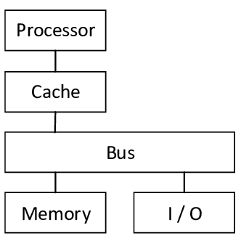
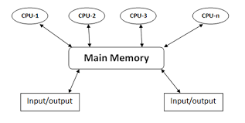
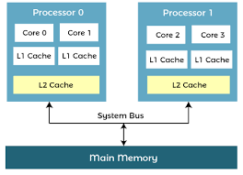
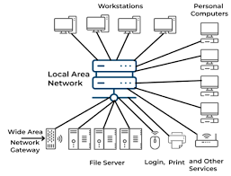
About Modern Computers
Single-processor
Multi-processor/Parallel computing
Multicore processor
Distributed Computing

Slide 32
About Modern OSs
Multiprogramming and timesharing are the central themes of modern OSs.
Multiprogramming and timesharing requires
  CPU scheduling
  Process synchronization and communication
  Deadlock detection
  Memory management and protection
  Virtual memory: A program is bigger than physical memory
  Online file systems.
  Disk management
  Security and protection
  Real-time and multimedia support
In this course, we will discuss
  key concepts/algorithms /ideas developed since 1950 on the preceding aspects/issues.

